Slide 1



E-waste classification using EfficientNet
Presented by – Kavin Raj N V

Slide 2

Learning Objectives
• Understand the concept of image classification using deep learning.
• Apply transfer learning with a pre-trained EfficientNet model.
• Learn how to perform data augmentation to improve model performance.
• Build and train a deep learning model for classifying e-waste images.
• Develop a simple web application using Gradio for model deployment.
• Analyze the results and understand the challenges in e-waste classification.
GOAL
Source :
www.freepk.com/

Slide 3
Tools and Technology used
• Python → Programming Language Used for Model Development
• TensorFlow / Keras → Deep Learning Libraries for Model Building & Training
• EfficientNetV2B0 → Pre-trained Model Used for Transfer Learning
• Google Colab → Cloud-based Notebook for Training & Testing
• Gradio → Web Framework for Building and Sharing AI Demos
• Matplotlib & Seaborn → Visualization Libraries for Plotting Graphs
• NumPy → Library for Numerical Operations & Array Handling
• Scikit-learn → Used for Evaluation Metrics (Confusion Matrix, Reports)
• PIL (Python Imaging Library) → Used for Image Processing & Resizing

Slide 4
Methodology
• Collected and preprocessed e-waste images (10 categories, resized to 128x128 pixels).
• Applied data augmentation techniques (flip, rotate, zoom) to improve model learning.
• Used transfer learning with EfficientNetV2B0 for feature extraction and fine-tuning.
• Trained the model using TensorFlow/Keras with Adam optimizer and 10 epochs.
• Evaluated model accuracy using test dataset and visualized results.
• Deployed the model using Gradio for simple web-based testing.

Slide 5
Problem Statement:
• Electronic waste (E-Waste) is increasing rapidly due to the widespread use of electronic devices.
• Proper classification of E-Waste is essential for efficient recycling and waste management.
• Manual sorting of E-Waste is time-consuming, inefficient, and prone to human error.
• There is a need for an automated, intelligent system to classify different categories of E-Waste.
• This project aims to develop a deep learning-based model to automatically classify various types of E-Waste images.

Slide 6
Solution:
• Developed an AI-based image classification model using Deep Learning.
• Utilized a pre-trained EfficientNetV2B0 model for Transfer Learning to classify E-Waste.
• Applied Data Augmentation techniques to improve model performance and prevent overfitting.
• Trained the model on categorized E-Waste images with 10 different classes.
• Achieved high classification accuracy through model fine-tuning and optimization.
• Deployed the trained model using Gradio for easy web-based testing and demonstrations.

Slide 7
Improvisations Done:
• Improved visualization by adding better graph styling using Seaborn.
• Applied Data Augmentation techniques (Flip, Rotation, Zoom) for better generalization.
• Deployed the trained model using Gradio for web-based testing.
• Displayed sample predictions along with actual labels for clear understanding.
• Added model performance visualization using Accuracy & Loss plots.

Slide 8
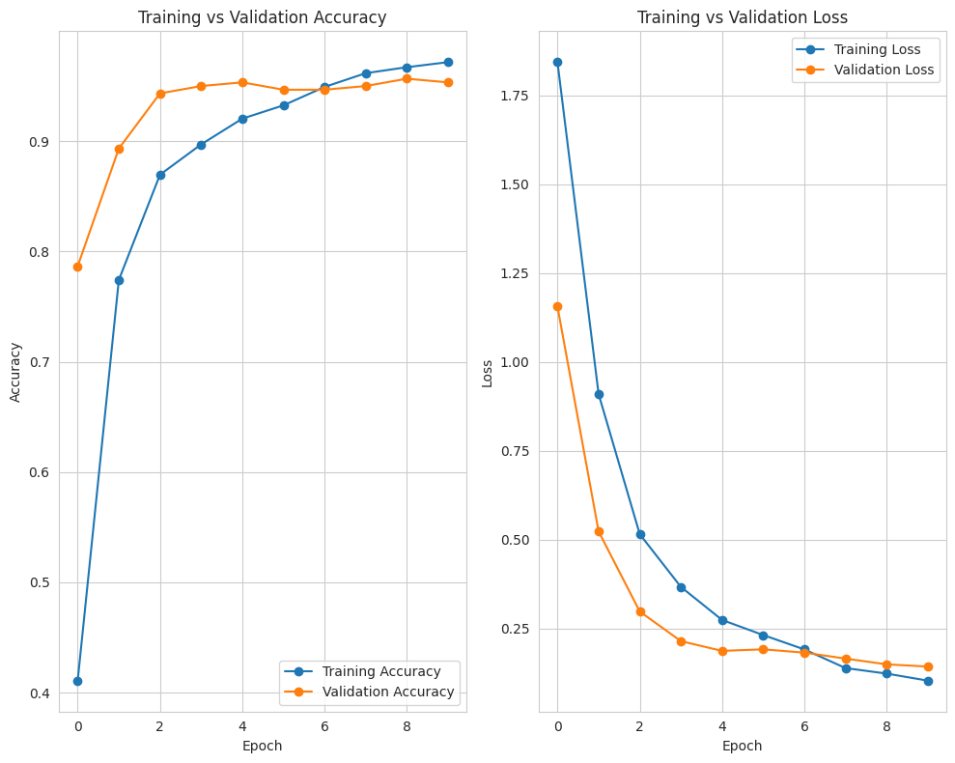
Screenshot of Output:
Model performance: Training & Validation Accuracy and Loss

Slide 9
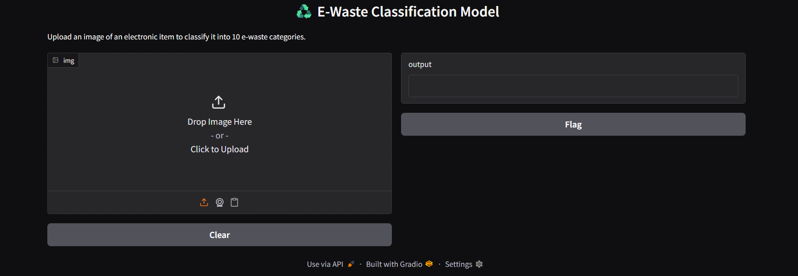
Screenshot of Output:
Gradio web interface

Slide 10
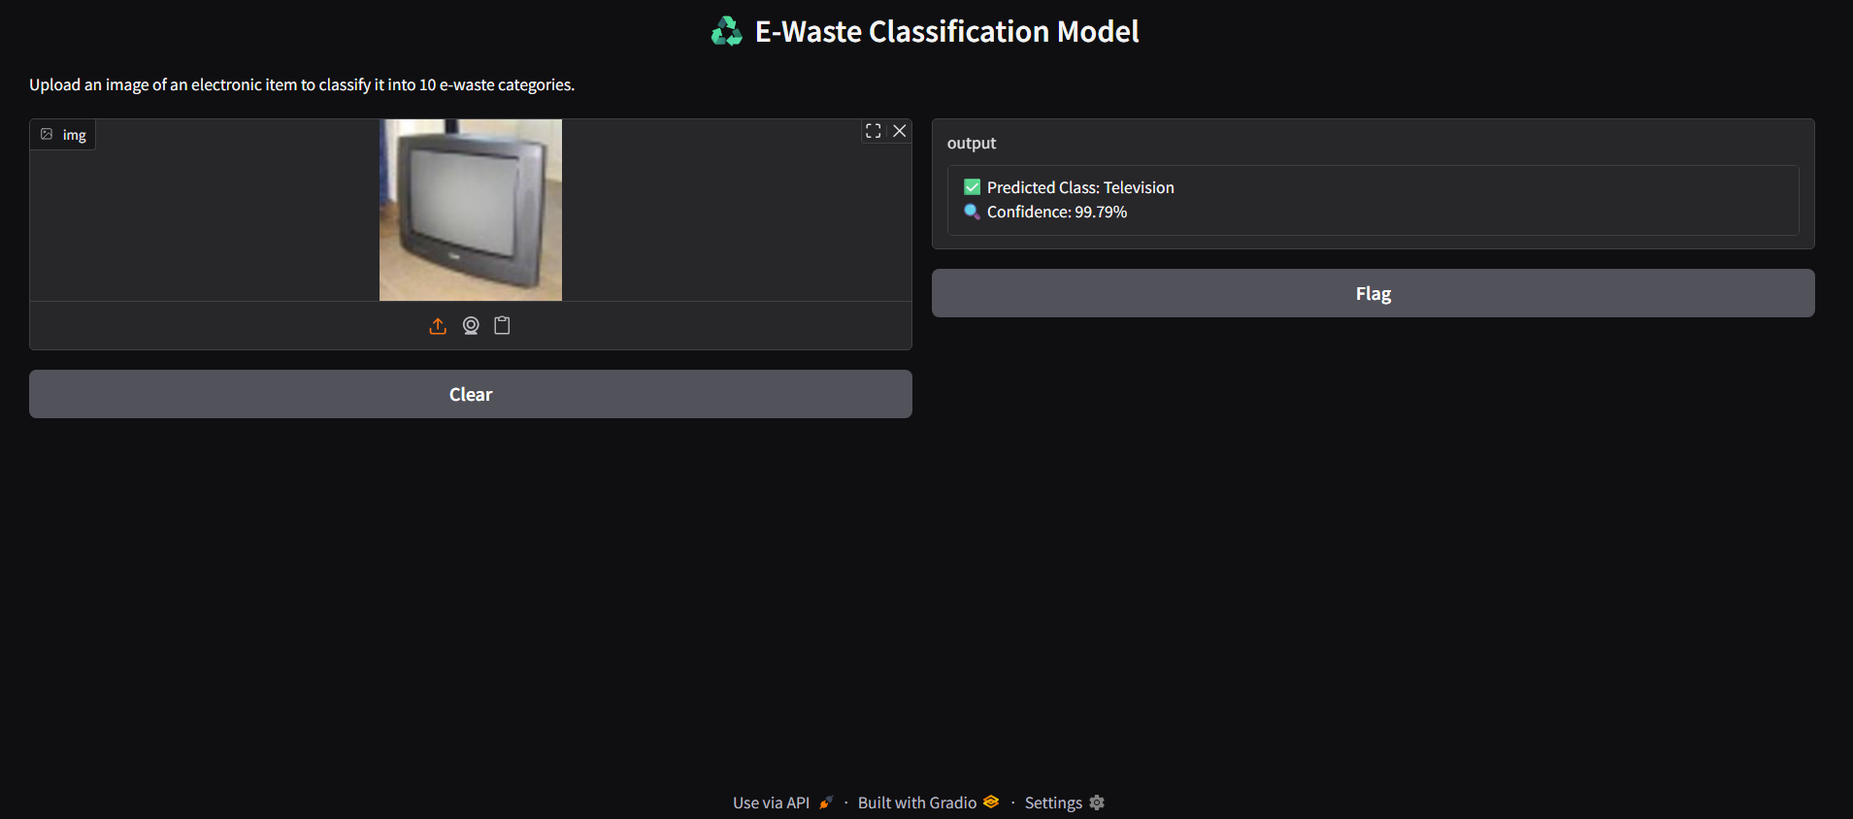
Screenshot of Output:
Prediction of Television with accuracy of 99.79%

Slide 11
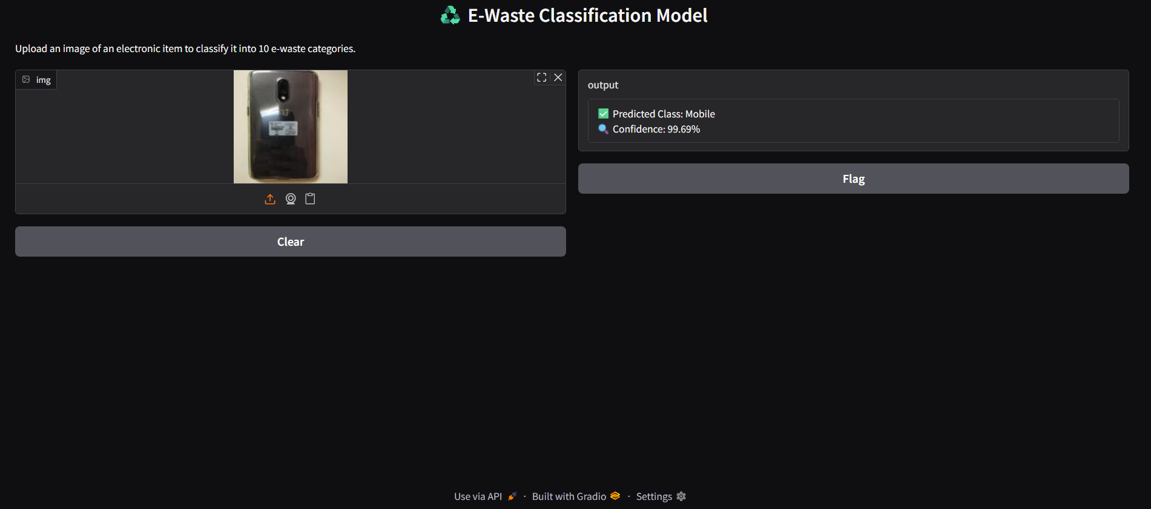
Screenshot of Output:
Prediction of mobile phone with accuracy of 99.69%

Slide 12
Conclusion:
• Successfully developed an AI-based image classification model for E-Waste detection.
• Achieved high accuracy using Transfer Learning with EfficientNetV2B0.
• Model can classify 10 categories of E-Waste effectively.
• Data Augmentation improved the model’s ability to generalize on unseen data.
• Deployed the model with a simple Gradio web interface for easy testing.
• This solution can help in automating E-Waste classification for better recycling and management processes.

